Slide 1
Warm-up:
What is the relationship between number of constraints and number of possible solutions?
In other words, as the number of the constraints increases,
does the number of possible solutions:
Increase
Decrease
Stay the same
Notes:
0=7, R=4, W=6, U=2, T=8, F=1; 867 + 867 = 1734

Slide 2
Announcements
Assignments:
P2: Optimization
Due Thu 2/21, 10 pm
Midterm 1 Exam
Mon 2/18, in class
Recitation Fri is a review session
See Piazza post for details
Alita Class Field Trip!
Moved to Saturday, 2/23, afternoon
White card feedback

Slide 3

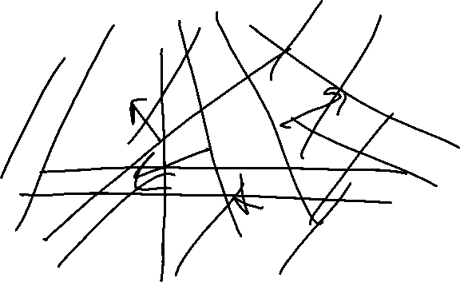
Warm-up:
What is the relationship between number of constraints and number of possible solutions?
In other words, as the number of the constraints increases,
does the number of possible solutions:
Increase
Decrease
Stay the same
Where is the knowledge in our CSPs?
Notes:
0=7, R=4, W=6, U=2, T=8, F=1; 867 + 867 = 1734

Slide 4

AI: Representation and Problem Solving
Propositional Logic
Instructors: Pat Virtue & Stephanie Rosenthal
Slide credits: CMU AI, http://ai.berkeley.edu

Slide 5
Logic Representation and Problem Solving
To honk or not to honk

Slide 6
Logical Agents
Logical agents and environments
Agent
Environment
Sensors
Percepts
Knowledge Base
Inference
?
Actuators
Actions

Slide 7
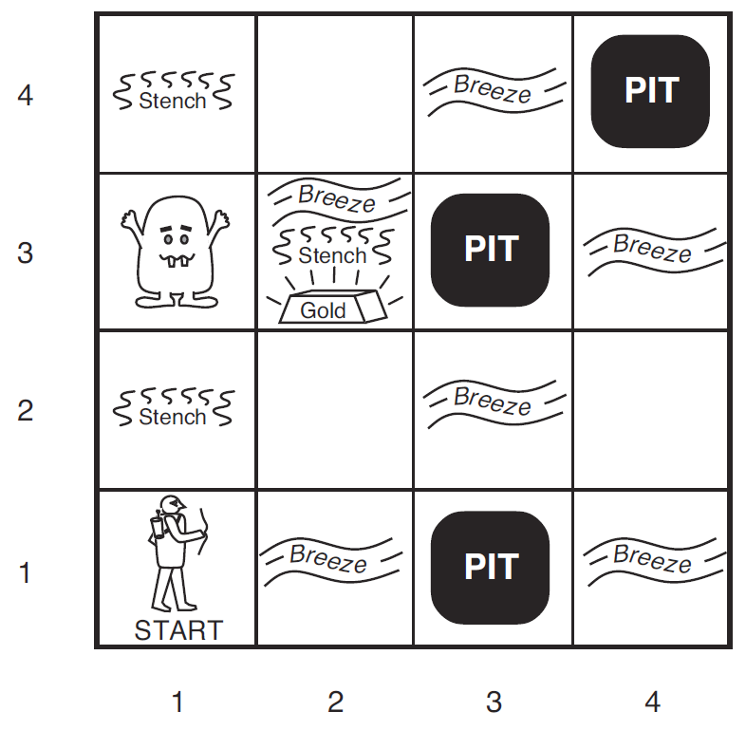

Wumpus World
Logical Reasoning as a CSP
B_{ij} = breeze felt
S_{ij} = stench smelt
P_{ij} = pit here
W_{ij} = wumpus here
G = gold
http://thiagodnf.github.io/wumpus-world-simulator/

Slide 8

A Knowledge-based Agent
function KB-AGENT(percept) returns an action
persistent: KB, a knowledge base
t, an integer, initially 0
TELL(KB, PROCESS-PERCEPT(percept, t))
action ← ASK(KB, PROCESS-QUERY(t))
TELL(KB, PROCESS-RESULT(action, t))
t←t+1
return action

Slide 9

Logical Agents
So what do we TELL our knowledge base (KB)?
Facts (sentences)
The grass is green
The sky is blue
Rules (sentences)
Eating too much candy makes you sick
When you’re sick you don’t go to school
Percepts and Actions (sentences)
Pat ate too much candy today
What happens when we ASK the agent?
Inference – new sentences created from old
Pat is not going to school today

Slide 10
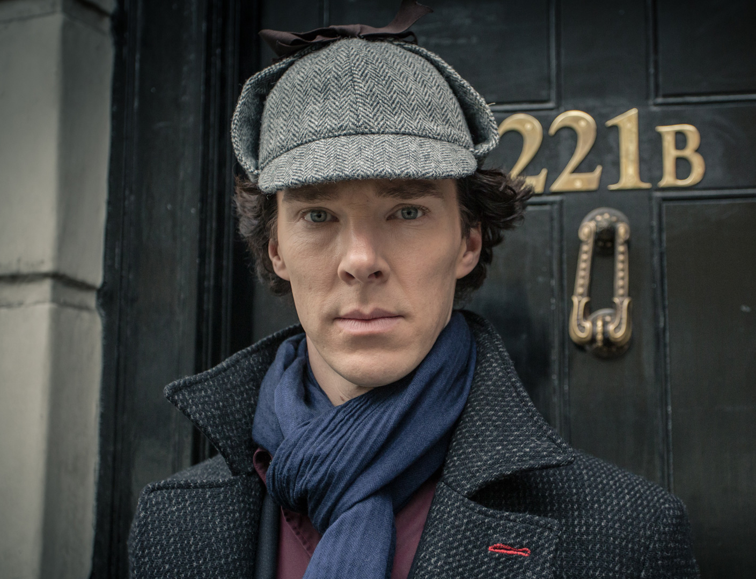
Logical Agents
Sherlock Agent
Really good knowledge base
Evidence
Understanding of how the world works (physics, chemistry, sociology)
Really good inference
Skills of deduction
“It’s elementary my dear Watson”
Dr. Strange?
Alan Turing?
Kahn?

Slide 11

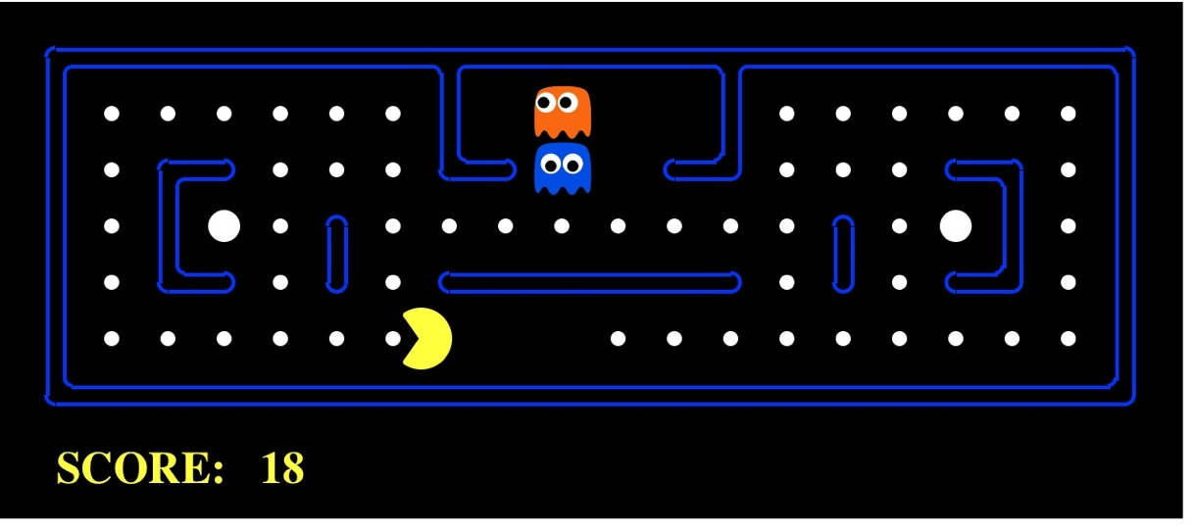
Worlds
What are we trying to figure out?
Who, what, when, where, why
Time: past, present, future
Actions, strategy
Partially observable? Ghosts, Walls
Which world are we living in?

Slide 12
Models
How do we represent possible worlds with models and knowledge bases?
How do we then do inference with these representations?

Slide 13
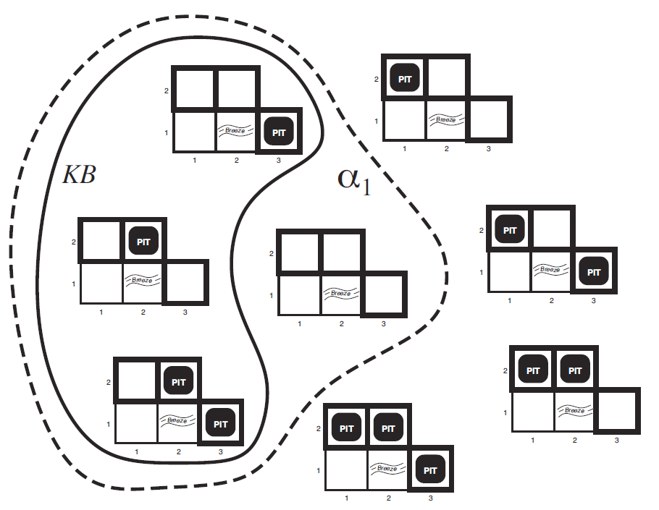

Wumpus World
Possible Models
P_{1,2} P_{2,2} P_{3,1}

Slide 14
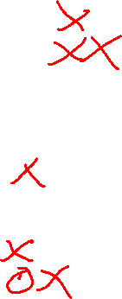

Wumpus World
Possible Models
P_{1,2} P_{2,2} P_{3,1}
Knowledge base
Nothing in [1,1]
Breeze in [2,1]

Slide 15
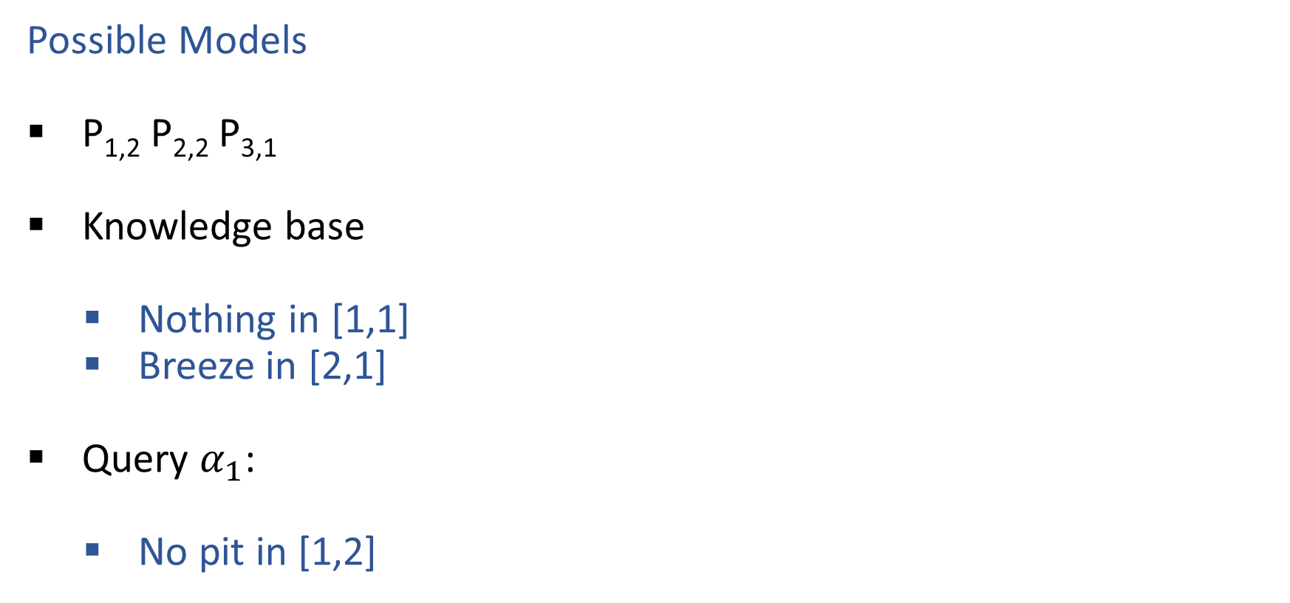
Wumpus World
Possible Models
P_{1,2} P_{2,2} P_{3,1}
Knowledge base
Nothing in [1,1]
Breeze in [2,1]
Query $α_{1}$:
No pit in [1,2]

Slide 16
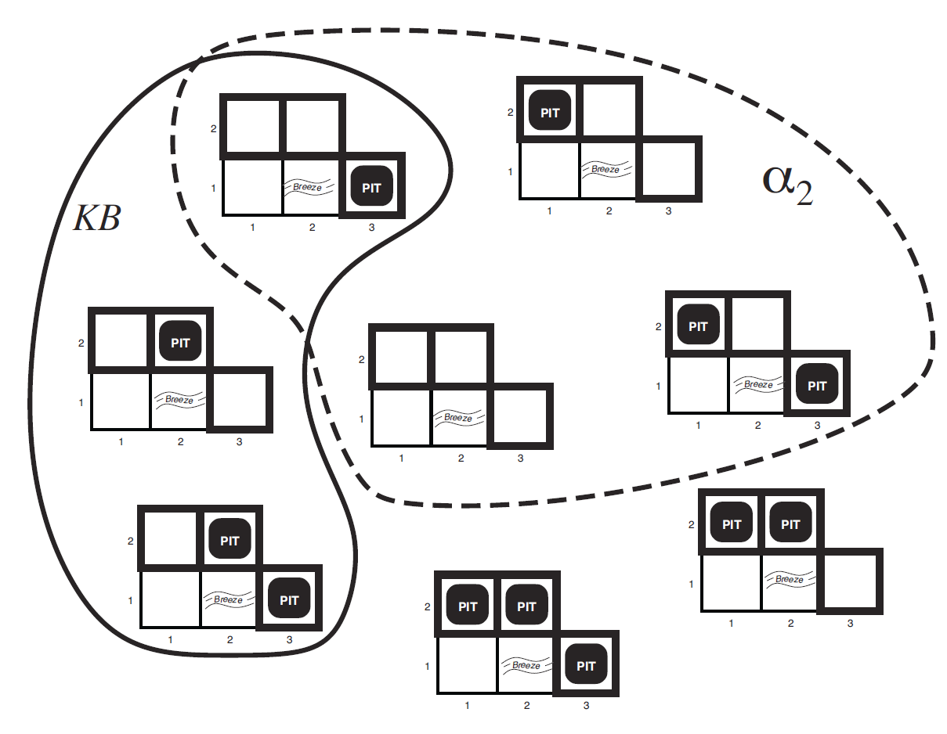


Wumpus World
Possible Models
P_{1,2} P_{2,2} P_{3,1}
Knowledge base
Nothing in [1,1]
Breeze in [2,1]
Query $α_{2}$:
No pit in [2,2]

Slide 17
Logic Language
Natural language?
Propositional logic
Syntax: P ∨ (¬Q ∧ R); X₁ ⇔ (Raining ⇒ Sunny)
Possible world: {P=true, Q=true, R=false, S=true} or 1101
Semantics: α ∧ β is true in a world iff is α true and β is true (etc.)
First-order logic
Syntax: ∀x ∃y P(x,y) ∧ ¬Q(Joe,f(x)) ⇒ f(x)=f(y)
Possible world: Objects o₁, o₂, o₃; P holds for <o₁,o₂>; Q holds for <o₃>; f(o₁)=o₁; Joe=o₃; etc.
Semantics: φ(σ) is true in a world if σ=o_{j} and φ holds for o_{j}; etc.

Slide 18
Propositional Logic

Slide 19
Propositional Logic
Symbol:
Variable that can be true or false
We’ll try to use capital letters, e.g. A, B, P_{1,2}
Often include True and False
Operators:
¬ A: not A
A ∧ B: A and B (conjunction)
A ∨ B: A or B (disjunction) Note: this is not an “exclusive or”
A ⇒ B: A implies B (implication). If A then B
A ⇔ B: A if and only if B (biconditional)
Sentences

Slide 20
Propositional Logic Syntax
Given: a set of proposition symbols {X₁, X₂, …, X_{n}}
(we often add True and False for convenience)
X_{i} is a sentence
If α is a sentence then ¬α is a sentence
If α and β are sentences then α ∧ β is a sentence
If α and β are sentences then α ∨ β is a sentence
If α and β are sentences then α ⇒ β is a sentence
If α and β are sentences then α ⇔ β is a sentence
And p.s. there are no other sentences!

Slide 21
Notes on Operators
𝛂 ∨ 𝛃 is inclusive or, not exclusive

Slide 22
Truth Tables
𝛂 ∨ 𝛃 is inclusive or, not exclusive
𝛂 | 𝛃 | 𝛂 ∧ 𝛃
F | F | F
F | T | F
T | F | F
T | T | T
𝛂 | 𝛃 | 𝛂 ∨ 𝛃
F | F | F
F | T | T
T | F | T
T | T | T

Slide 23
Notes on Operators
𝛂 ∨ 𝛃 is inclusive or, not exclusive
𝛂 ⇒ 𝛃 is equivalent to ¬𝛂 ∨ 𝛃
Says who?

Slide 24

Truth Tables
𝛂 ⇒ 𝛃 is equivalent to ¬𝛂 ∨ 𝛃
𝛂 | 𝛃 | 𝛂 ⇒ 𝛃 | ¬𝛂 | ¬𝛂 ∨ 𝛃
F | F | T | T | T
F | T | T | T | T
T | F | F | F | F
T | T | T | F | T

Slide 25
Notes on Operators
𝛂 ∨ 𝛃 is inclusive or, not exclusive
𝛂 ⇒ 𝛃 is equivalent to ¬𝛂 ∨ 𝛃
Says who?
𝛂 ⇔ 𝛃 is equivalent to (𝛂 ⇒ 𝛃) ∧ (𝛃 ⇒ 𝛂)
Prove it!

Slide 26

Truth Tables
𝛂 ⇔ 𝛃 is equivalent to (𝛂 ⇒ 𝛃) ∧ (𝛃 ⇒ 𝛂)
𝛂 | 𝛃 | 𝛂 ⇔ 𝛃 | 𝛂 ⇒ 𝛃 | 𝛃 ⇒ 𝛂 | (𝛂⇒𝛃) ∧ (𝛃⇒𝛂)
F | F | T | T | T | T
F | T | F | T | F | F
T | F | F | F | T | F
T | T | T | T | T | T
Equivalence: it’s true in all models. Expressed as a logical sentence:
(𝛂 ⇔ 𝛃) ⇔ [(𝛂 ⇒ 𝛃) ∧ (𝛃 ⇒ 𝛂)]

Slide 27
Literals
A literal is an atomic sentence:
True
False
Symbol
¬ Symbol

Slide 28
Monty Python Inference
There are ways of telling whether she is a witch

Slide 29
Sentences as Constraints
Adding a sentence to our knowledge base constrains the
number of possible models:
KB: Nothing
Possible
Models
P | Q | R
false | false | false
false | false | true
false | true | false
false | true | true
true | false | false
true | false | true
true | true | false
true | true | true

Slide 30
Sentences as Constraints
Adding a sentence to our knowledge base constrains the
number of possible models:
KB: Nothing
KB: [(P ∧ ¬Q) ∨ (Q ∧ ¬P)] ⇒ R
Possible
Models
P | Q | R
false | false | false
false | false | true
false | true | false
false | true | true
true | false | false
true | false | true
true | true | false
true | true | true

Slide 31

Sentences as Constraints
Adding a sentence to our knowledge base constrains the
number of possible models:
KB: Nothing
KB: [(P ∧ ¬Q) ∨ (Q ∧ ¬P)] ⇒ R
KB: R, [(P ∧ ¬Q) ∨ (Q ∧ ¬P)] ⇒ R
Possible
Models
P | Q | R
false | false | false
false | false | true
false | true | false
false | true | true
true | false | false
true | false | true
true | true | false
true | true | true

Slide 32

Sherlock Entailment
“When you have eliminated the impossible, whatever remains, however improbable, must be the truth” – Sherlock Holmes via Sir Arthur Conan Doyle
Knowledge base and inference allow us to remove impossible models, helping us to see what is true in all of the remaining models

Slide 33

Entailment
Entailment: α |= β (“α entails β” or “β follows from α”) iff in every world where α is true, β is also true
I.e., the α-worlds are a subset of the β-worlds [models(α) ⊆ models(β)]
Usually we want to know if KB |= query
models(KB) ⊆ models(query)
In other words
KB removes all impossible models (any model where KB is false)
If β is true in all of these remaining models, we conclude that β must be true
Entailment and implication are very much related
However, entailment relates two sentences, while an implication is itself a sentence (usually derived via inference to show entailment)

Slide 34
Wumpus World
Possible Models
P_{1,2} P_{2,2} P_{3,1}
Knowledge base
Nothing in [1,1]
Breeze in [2,1]

Slide 35
Wumpus World
Possible Models
P_{1,2} P_{2,2} P_{3,1}
Knowledge base
Nothing in [1,1]
Breeze in [2,1]
Query $α_{1}$:
No pit in [1,2]

Slide 36
Wumpus World
Possible Models
P_{1,2} P_{2,2} P_{3,1}
Knowledge base
Nothing in [1,1]
Breeze in [2,1]
Query $α_{2}$:
No pit in [2,2]

Slide 37
Propositional Logic Models
All Possible Models
A | 0 | 0 | 0 | 0 | 1 | 1 | 1 | 1
B | 0 | 0 | 1 | 1 | 0 | 0 | 1 | 1
C | 0 | 1 | 0 | 1 | 0 | 1 | 0 | 1
Model Symbols

Slide 38
Piazza Poll 1
Entailment: α |= β
“α entails β” iff in every world where α is true, β is also true
Does the KB entail query C?
All Possible Models
A | 0 | 0 | 0 | 0 | 1 | 1 | 1 | 1
B | 0 | 0 | 1 | 1 | 0 | 0 | 1 | 1
C | 0 | 1 | 0 | 1 | 0 | 1 | 0 | 1
A | 0 | 0 | 0 | 0 | 1 | 1 | 1 | 1
B⇒C | 1 | 1 | 0 | 1 | 1 | 1 | 0 | 1
A⇒B∨C | 1 | 1 | 1 | 1 | 0 | 1 | 1 | 1
C | 0 | 1 | 0 | 1 | 0 | 1 | 0 | 1
Model Symbols
Knowledge Base
Query

Slide 39
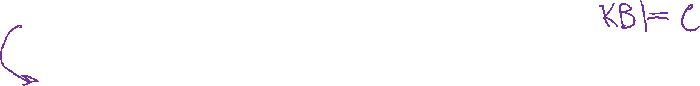
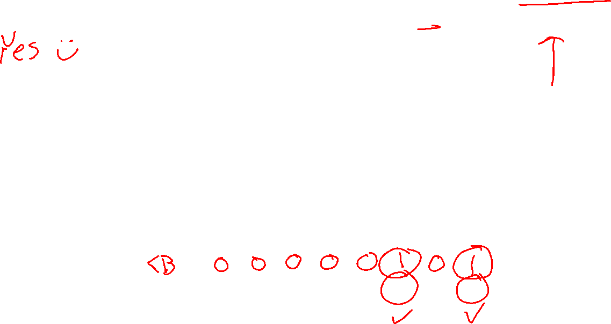
Piazza Poll 1
Entailment: α |= β
“α entails β” iff in every world where α is true, β is also true
Does the KB entail query C?
All Possible Models
A | 0 | 0 | 0 | 0 | 1 | 1 | 1 | 1
B | 0 | 0 | 1 | 1 | 0 | 0 | 1 | 1
C | 0 | 1 | 0 | 1 | 0 | 1 | 0 | 1
A | 0 | 0 | 0 | 0 | 1 | 1 | 1 | 1
B⇒C | 1 | 1 | 0 | 1 | 1 | 1 | 0 | 1
A⇒B∨C | 1 | 1 | 1 | 1 | 0 | 1 | 1 | 1
C | 0 | 1 | 0 | 1 | 0 | 1 | 0 | 1
Model Symbols
Knowledge Base
Query

Slide 40
Entailment
How do we implement a logical agent that proves entailment?
Logic language
Propositional logic
First order logic
Inference algorithms
Theorem proving
Model checking

Slide 41
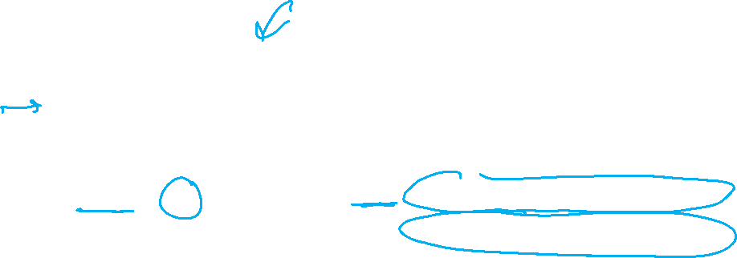
Propositional Logic
Check if sentence is true in given model
In other words, does the model satisfy the sentence?
function PL-TRUE?(α,model) returns true or false
if α is a symbol then return Lookup(α, model)
if Op(α) = ¬ then return not(PL-TRUE?(Arg1(α),model))
if Op(α) = ∧ then return and(PL-TRUE?(Arg1(α),model),
PL-TRUE?(Arg2(α),model))
etc.
(Sometimes called “recursion over syntax”)

Slide 42
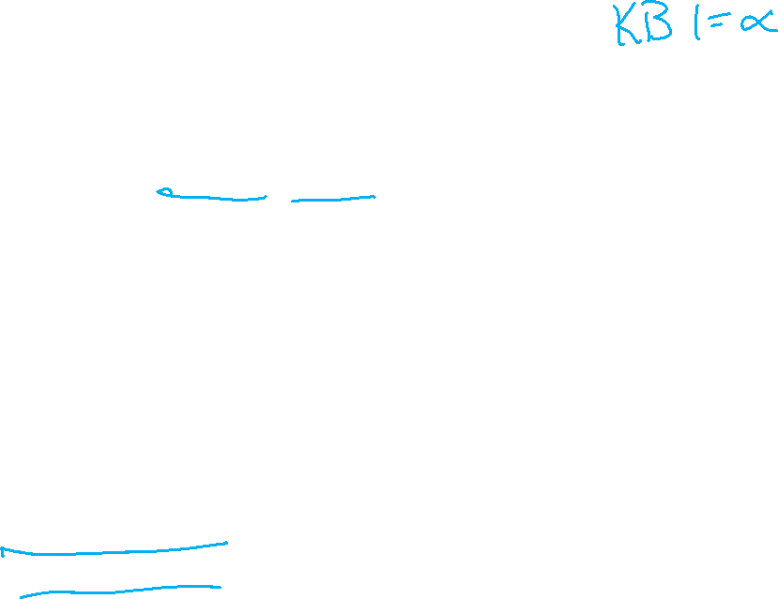
Simple Model Checking
function TT-ENTAILS?(KB, α) returns true or false return TT-CHECK-ALL(KB, α, symbols(KB) U symbols(α),{})
function TT-CHECK-ALL(KB, α, symbols,model) returns true or false
if empty?(symbols) then
if PL-TRUE?(KB, model) then return PL-TRUE?(α, model)
else return true
else
P ← first(symbols) rest ← rest(symbols) return and (TT-CHECK-ALL(KB, α, rest, model ∪ {P = true})
TT-CHECK-ALL(KB, α, rest, model ∪ {P = false }))

Slide 43
Simple Model Checking, contd.
Same recursion as backtracking
O(2^{n}) time, linear space
We can do much better!
P₁=true
P₁=false
P₂=true
P₂=false
P_{n}=true
P_{n}=false
KB?
α?
11111…1
0000…0

